Slide 1

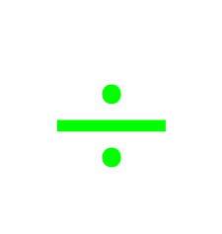







My Number
Interactive Notebook
$$×$$
$$\frac{1}{2}$$
$$÷$$
$$+$$
$$−$$
$$\frac{3}{5}$$
$$7$$
Name
Class
Teacher
Term 1 Semester 1
$$5^{2}$$
$$\sqrt{9}$$
1

Slide 2
Contents
Glossary or Formula Page
Page
Date
Description
2
3

Slide 3
Tasks
24
7
30
Essential Question
Questions
Notes
Summary
8
9

Slide 4
Starter activity
Draw a square on the grid with and area of 9 squares.
What is the side length of this square?
Draw a square on the grid with and area of 25 squares.
What is the side length of this square?
Demo link

Slide 5
24
7
30
Date
Index Notation
EQ – Describe the relationship between squaring a number and finding the square root?
9

Slide 6
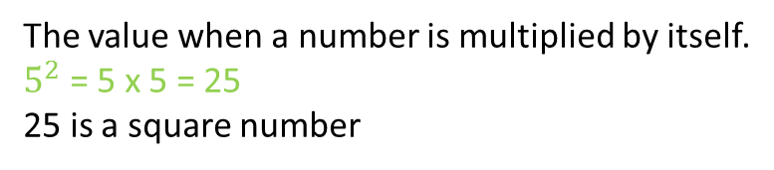
24
7
30
Date
Index Notation
EQ – Describe the relationship between squaring a number and finding the square root?
What is a square number?
The value when a number is multiplied by itself.
$5^{2}$ = 5 x 5 = 25
25 is a square number
9

Slide 7
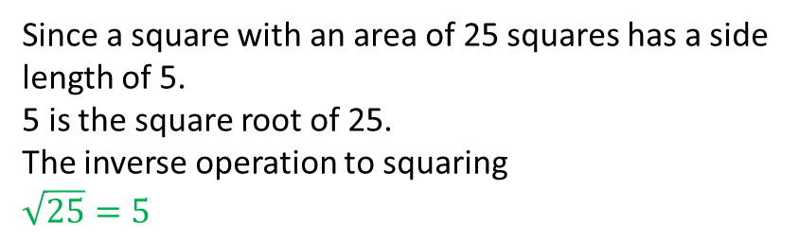
24
7
30
Date
Index Notation
EQ – Describe the relationship between squaring a number and finding the square root?
What is a square number?
The value when a number is multiplied by itself.
$5^{2}$ = 5 x 5 = 25
25 is a square number
What the square root?
Since a square with an area of 25 squares has a side length of 5.
5 is the square root of 25.
The inverse operation to squaring
$$\sqrt{25}=5$$
9

Slide 8

Task – Find the following
$\sqrt{4}$
$\sqrt{100}$
$\sqrt{49}$

Slide 9
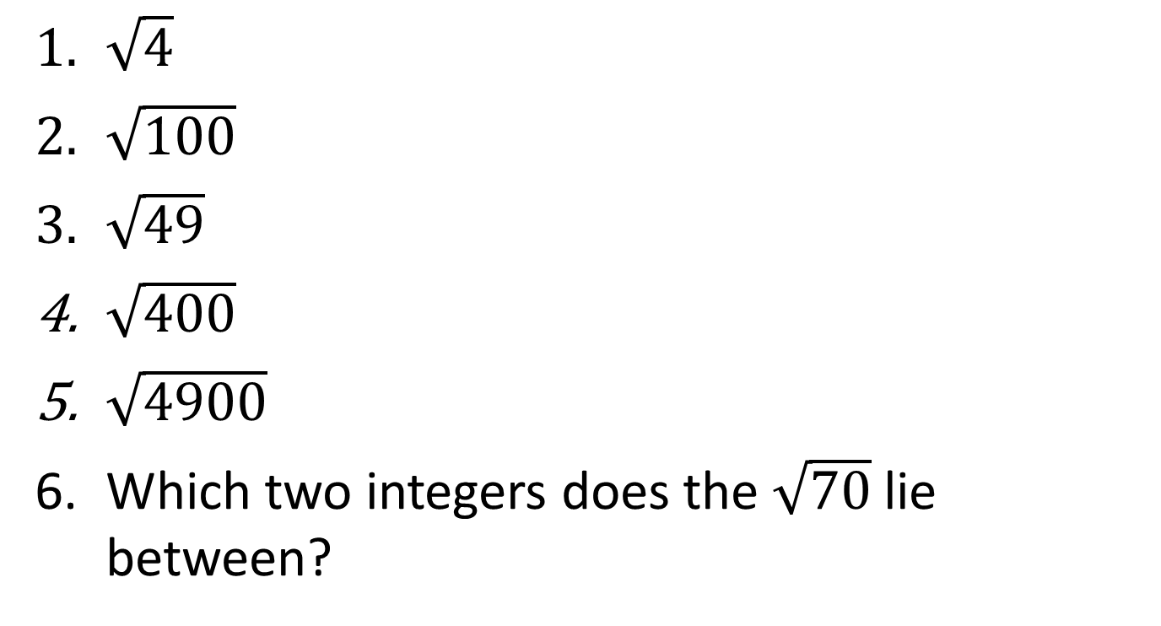
Task – Find the following
$\sqrt{4}$
$\sqrt{100}$
$\sqrt{49}$
$\sqrt{400}$
$\sqrt{4900}$
Which two integers does the $\sqrt{70}$lie between?

Slide 10


Calculate the following
$1^{2}=1×1=1$
$2^{2}$
$3^{2}$
$4^{2}$
$5^{2}$
$6^{2}$
$7^{2}$
$8^{2}$
$9^{2}$
${10}^{2}$
${11}^{2}$
${12}^{2}$

Slide 11
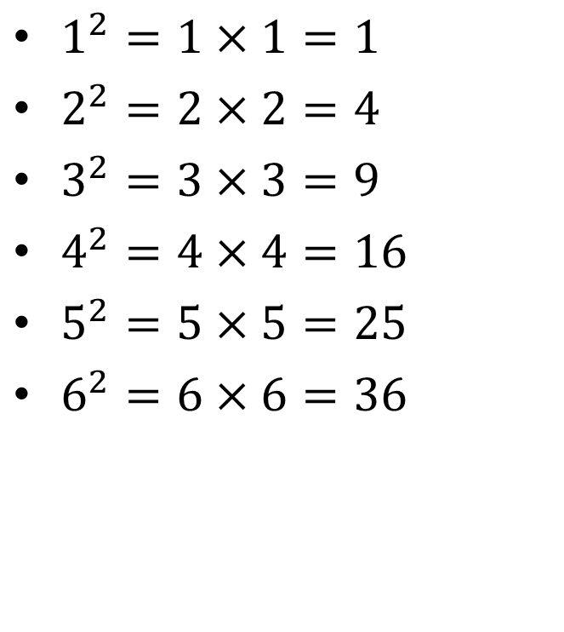
Calculate the following
$1^{2}=1×1=1$
$2^{2}=2×2=4$
$3^{2}=3×3=9$
$4^{2}=4×4=16$
$5^{2}=5×5=25$
$6^{2}=6×6=36$
$7^{2}$
$8^{2}$
$9^{2}$
${10}^{2}$
${11}^{2}$
${12}^{2}$

Slide 12
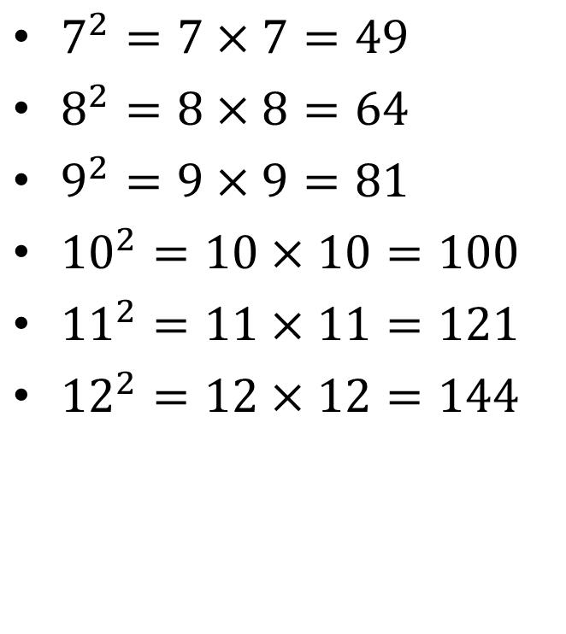
Calculate the following
$1^{2}=1×1=1$
$2^{2}=2×2=4$
$3^{2}=3×3=9$
$4^{2}=4×4=16$
$5^{2}=5×5=25$
$6^{2}=6×6=36$
$7^{2}=7×7=49$
$8^{2}=8×8=64$
$9^{2}=9×9=81$
${10}^{2}=10×10=100$
${11}^{2}=11×11=121$
${12}^{2}=12×12=144$

Slide 13

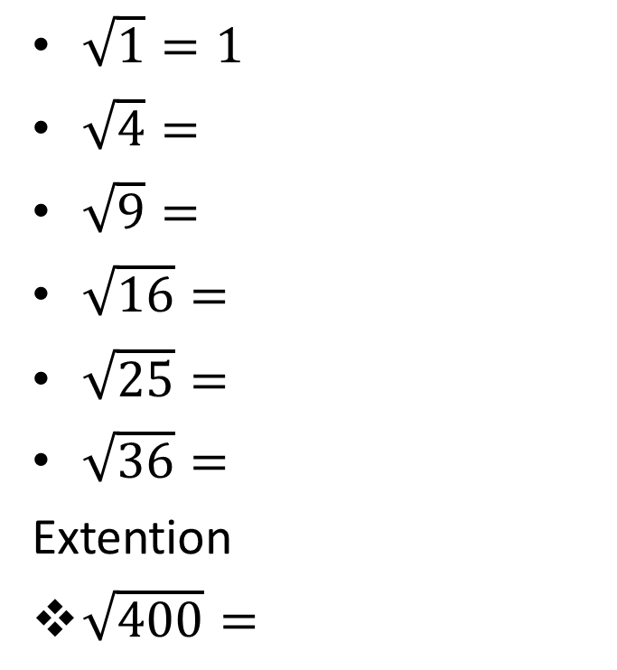
Calculate the following
$\sqrt{1}=1$
$\sqrt{4}=$
$\sqrt{9}=$
$\sqrt{16}=$
$\sqrt{25}=$
$\sqrt{36}=$
Extention
$\sqrt{400}=$
$\sqrt{49}=$
$\sqrt{64}=$
$\sqrt{81}=$
$\sqrt{100}=$
$\sqrt{121}=$
$\sqrt{144}=$
$\sqrt{2500}=$

Slide 14
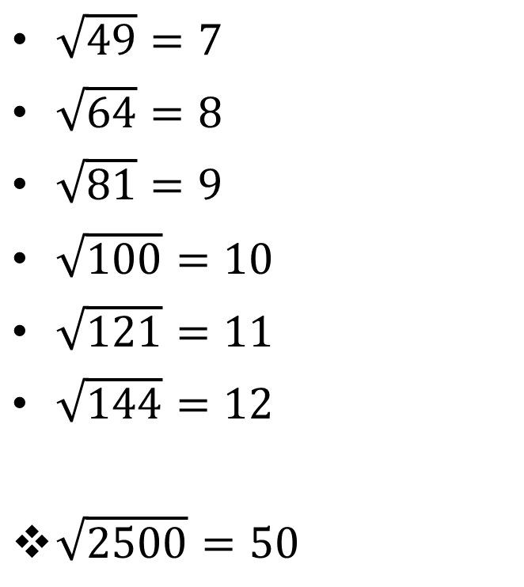
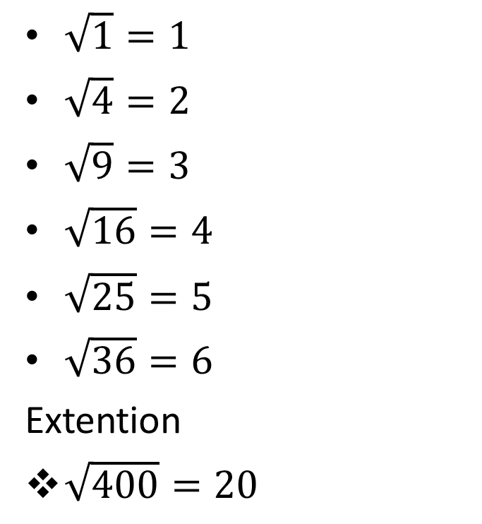
Calculate the following
$\sqrt{1}=1$
$\sqrt{4}=2$
$\sqrt{9}=3$
$\sqrt{16}=4$
$\sqrt{25}=5$
$\sqrt{36}=6$
Extention
$\sqrt{400}=20$
$\sqrt{49}=7$
$\sqrt{64}=8$
$\sqrt{81}=9$
$\sqrt{100}=10$
$\sqrt{121}=11$
$\sqrt{144}=12$
$\sqrt{2500}=50$

Slide 15
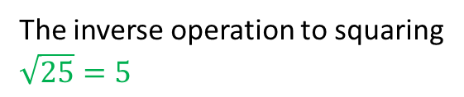
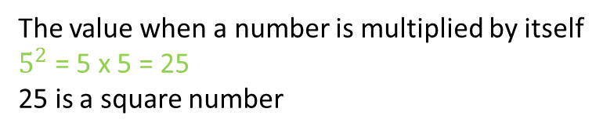
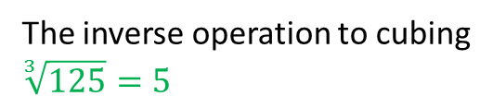
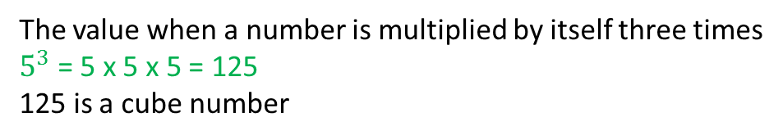
24
7
30
Date
Index Notation
EQ – Describe the relationship between squaring a number and finding the square root?
What is a square number?
The value when a number is multiplied by itself
$5^{2}$ = 5 x 5 = 25
25 is a square number
What the square root?
The inverse operation to squaring
$$\sqrt{25}=5$$
What is a cube number?
The value when a number is multiplied by itself three times
$5^{3}$ = 5 x 5 x 5 = 125
125 is a cube number
The inverse operation to cubing
$$\sqrt[3]{125}=5$$
What the cube root?
9

Slide 16
Notes Review
24, 7 ,30
Date
Title
Essential question
Notes complete
Notes complete with colour and diagrams
Questions completed
Contents page filed in
Formula page filled in

Slide 17
Homework
Review your notes and write a summary answering the essential question.

